Slide 1
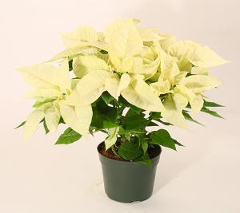
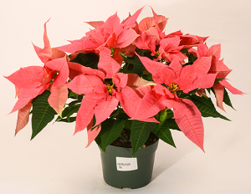
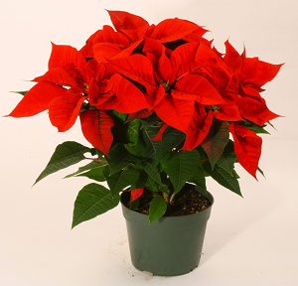
Poinsettia 2018
6” Poinsettia White
6” Poinsettia Pink
6” Poinsettia Red
All 3 colors come in 2 different sizes 4” and 6” Red only available in 10”

